Slide 1



Welcome to
Public Cyber Security
2017

Slide 2


Jisc technologies
7th Dec2017
Steve Kennett Director of Security & Senior Information Risk Owner
Notes:
Go to ‘View’ menu > ‘Header and Footer…’ to edit the footers on this slide (click ‘Apply’ to change only the currently selected slide, or ‘Apply to All’ to change the footers on all slides).
To change the image on this slide:
Click once on the image to select it, and then delete it
Drag a replacement picture to the placeholder or click the icon in the centre of the placeholder to browse for & add another image
Once you have added your replacement image, you may need to put it into the background so that it doesn’t cover other items on the slide. Do this by right-clicking on the new image and choosing ‘Arrange’ > ‘Send to Back’ from the contextual menu
Once added, the image can be cropped, resized or repositioned to suit.

Slide 3
Jisc Cyber Security Division
Vision
The vision is to help research and education institutions increase their capability to respond to online security concerns and to help them undergo the cultural change required for effective information security

Slide 4
Jisc Cyber Security Division
Mission
Our mission is to safeguard the current and future network and information security of the Janet network and of our customers’ networks, creating a secure environment for our customers and their users to conduct innovative online activities. To do this we will continue to develop and refine products and services to help support an institution’s information security policy and to ensure continuity of business.

Slide 5
Jisc Cyber Security Division New Approach
PEOPLE
Staff Training & awareness
Professional Skills & Certifications
Competent Resources
TECHNOLOGY
You can’t deploy technology without competent people, support, processes, or an overall plan
PROCESS
Management Systems
Governance Frameworks
Best Practice
IT Audits
Development Operations

Slide 6
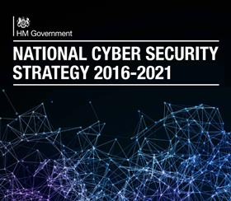
National Cyber Security Strategy
https://www.gov.uk/government/publications/national-cyber-security-strategy-2016-to-2021
Notes:
The interconnectedness of the internet brings huge benefits to the world but also unrivalled opportunity for harm
DEFEND We have the means to defend the UK Academic sector and the NREN & against evolving cyber threats, to respond effectively to incidents, to ensure UK networks, data and systems are protected and resilient. Our members have the knowledge and ability to defend themselves.
DETER The UK will be a hard target for all forms of aggression in cyberspace. We detect, understand, investigate and disrupt hostile action taken against us, pursuing and prosecuting offenders. We have the means to take offensive action in cyberspace, should we choose to do so.
DEVELOP We have an innovative, growing cyber security development programme, underpinned by worldleading scientific research and development. Jisc have a self-sustaining pipeline of talent providing the skills to meet our national needs across the public and private sectors. Our cutting-edge analysis and expertise will enable the UK Sector to meet and overcome future threats and challenges.

Slide 7
GCHQ sees Credible threats
Steal intellectual property
Take commercially sensitive data , such as key negotiating positions
Gain unauthorised access to government and defence related information
Disrupt government and industry service
Exploit information security weaknesses through targeting partners, subsidiaries and supply chains at home and abroad

Slide 8

What is a Cyber Security Incident
The NCSC defines a cyber security incident as:
A breach of a system’s security policy in order to affect its integrity or availability
The unauthorised access or attempted access to a system
Notes:
Activities commonly recognised as security policy breaches are:
attempts to gain unauthorised access to a system and/or to data
the unauthorised use of systems and/or data
modification of a system's firmware, software or hardware without the system-owner's consent
malicious disruption and/or denial of service
15189 incidents

Slide 9
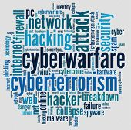
Who is Attacking
Notes:
47.4% of Total UK Crime is Cyber Crime
30.5% cyber enabled
16.9% Cyber dependent
Source ONS

Slide 10




You Need one of These

Slide 11
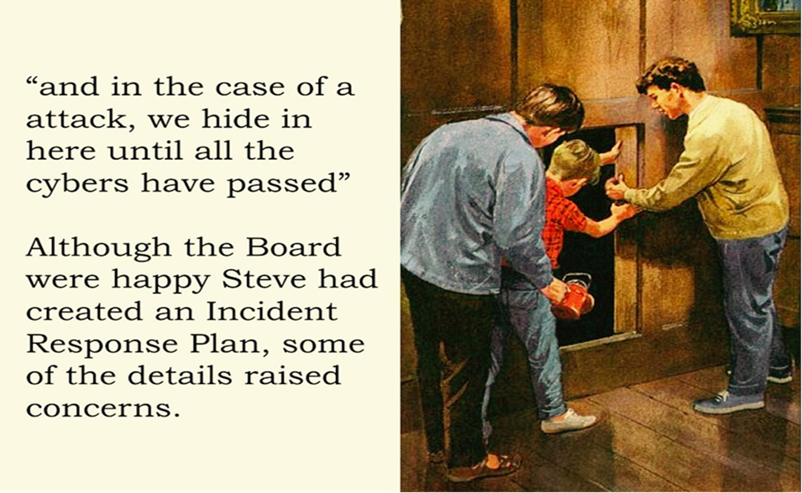
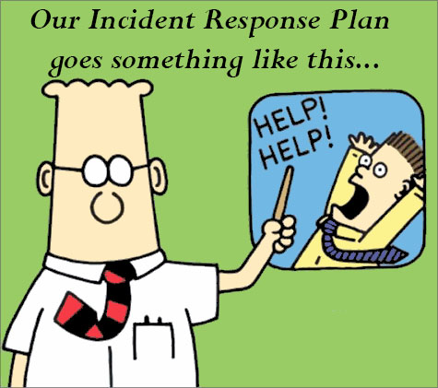
Helpful? Good Idea!

Slide 12


The Plan is the Thing

Slide 13
The Plan is the Thing
  Preparation
  Identification
  Notification
  Mitigation Strategy
  Containment
  Eradication
  Recovery
  Lessons Learned
Templates

Slide 14
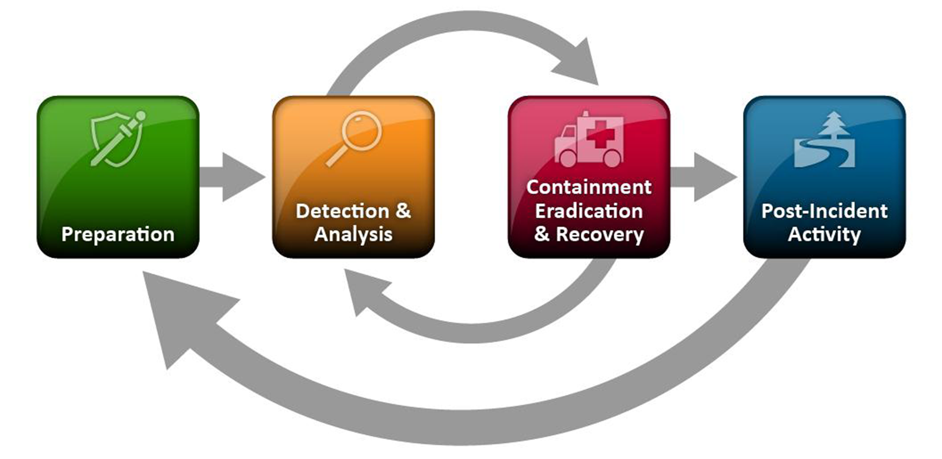
Incident Response

Slide 15
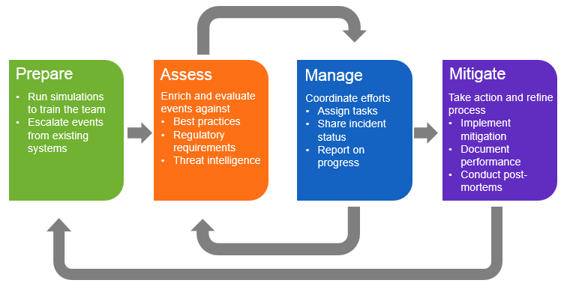
Incident Response

Slide 16
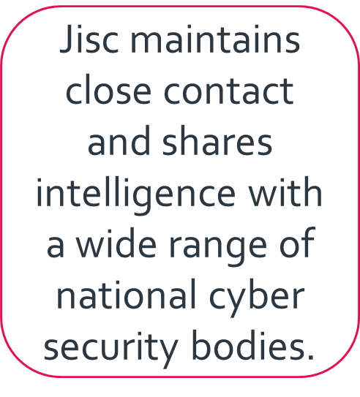
Jisc Cyber Security Landscape
Jisc Cyber Security
DCMS
National Cyber Security Centre
Home Office
PREVENT
Security Intelligence Agencies
Counter Terrorism Internet Referral Unit
National Crime Agency
Internet Watch Foundation
Notes:
The threat landscape is evolving rapidly
Collaboration with peer organizations is vital
Determine core competencies, perform functions that you do well, outsource others
Some security functions must be done in partnership with your service provider(s)
Take advantage of government resources: standards, programs, events, consortiums, services
Information sharing partnerships are essential

Slide 17
Jisc Security Operations Centre
Janet CSIRT is the Computer Security Incident Response Team for the Janet network.
They are responsible for the coordination and resolution of incidents that occur within organisations connected to Janet.
They work with organisations within the UK and internationally to assist in crime investigation.
Gather intelligence on potential security issues and report them to connected organisations.
First port of call for when a member or customer may be experiencing a security issue.
Notes:
Recent rasnsomware
Wannacry 0 infections reported
Recent malvertising attack first reported by UCL
Petya/not petya
Information provided to IT Directors by Jisc Security Director on how to protect institutions from each attack vector and what to do if site infected
updates provided to Ian Coates
Director, Higher Education Strategy & Policy
Mob: 07824 596797
www.gov.uk/dfe

Slide 18
Cyber Security on Janet
Top 5 threats we see today
Phishing attacks
Ransomware
DDoS
Malware
System compromise
Notes:
Based on feedback from the posture survey and from our own experiences in CSIRT and the Analyst teams, these are the top five threats we see on Janet.

Slide 19
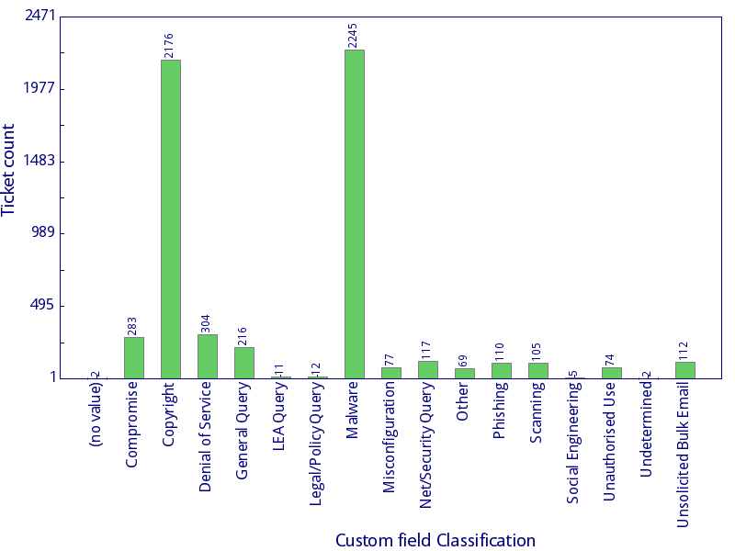
Incidents 2017
2017 Incidents
2245 Malware incidents
2176 Copyright incidents
304 DoS incidents
Lots of others including
law enforcement and legal
3-Aug-17
CSIRT
19
Notes:
CSIRT have dealt with lots this year.
Automation has helped us to send alerts out quickly and efficiently.
Originally our malware incident automation system was delivered by an external provider.
They increased the costs, so we decided to take this task in house.
The programming team inside CSIRT are very talented.
CSIRT people have to be capable, at programming, diplomacy, security and have an understanding of legal.

Slide 20

Fake News
Russian, Chinese, Middle Eastern and English language sites are offering all kinds of services based around manipulating social media, search engines and news organisations.
Mounting a year-long fake news campaign can cost about £315,000
The services on offer included:
  Creating celebrities
  Sparking social unrest including demonstrations
  Discrediting journalists
  Putting sustained pressure on elections or political parties

Slide 21
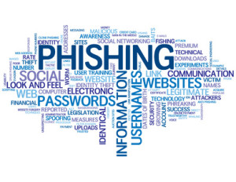
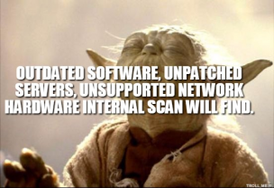
How does ransomware infect your system?

Slide 22
Vulnerability Management
Gives a stronger handle against billions of malware, often undetected by other tools
Provides the same view on your network as the adversary has, reducing the attack surface
before something happens
Helps to focus on what matters most to strengthen the resilience of your network,
Maximizes the effectiveness and efficiency of IT security teams

Slide 23

New security services in the past 12 months
Vulnerability assessment and information
Threat information abuse helper
Web filtering
Safe share
Phishing service
Personal certificates for email
In-house penetration testing
Notes:
Vulnerability assessment and information: External and on-site options automated vulnerability testing by Khipu. Single supplier framework. Charges.
Threat information abuse helper: UK wide and drill-down displays and information about threats. Over 300 organisation signed-up. No charge.
Web filtering: filtering under institution control with IWF anti-radicalisation filter available. 7 suppliers on a framework. Charges.
Safe share: Higher assurance connectivity over the Janet network and access management mechanisms between research centres.
Phishing service: Test uptake of phishing emails in an organisation. Training also linked to this. Charges.
Personal certificates for email: S/MIME certificates to assure identify of email sender and optionally to encrypt contents.
In-house penetration testing: chargeable service; as in-house can also do this as part of incident response in an emergency (for no charge)
<CLICK> Gets yellow highlight on two services that meet the “top products” request from FE.

Slide 24

Jisc cyber security training
Computers, privacy and the law (live online course)
Effective identification and management of security Incidents
Filtering and monitoring: how they can help?
Hand on digital forensics
Hands on security testing (live online course)
Information security policies (live online course)
Managing IT security
GDPR Foundation and GDPR Practitioner
www.jisc.ac.uk/advice/training/network
Notes:
GDPR Foundation – one day
GDPR Practitioner – four days including an exam
Run in Manchester and London

Slide 25
Services in development
Cyber Security Portal
Customer DDoS mitigation services
DDoS mitigation service enhancement
Threat information reporting
Cyber Essentials assessment
Security audit services
New Janet DNS resolver service
Digital forensics service
New Janet NTP service
Passive DNS
Security X-Ray service
Email filtering enhancements
Intrusion detection service
Central scanning of Jane public address space
Centrally managed scanning of member networks

Slide 26

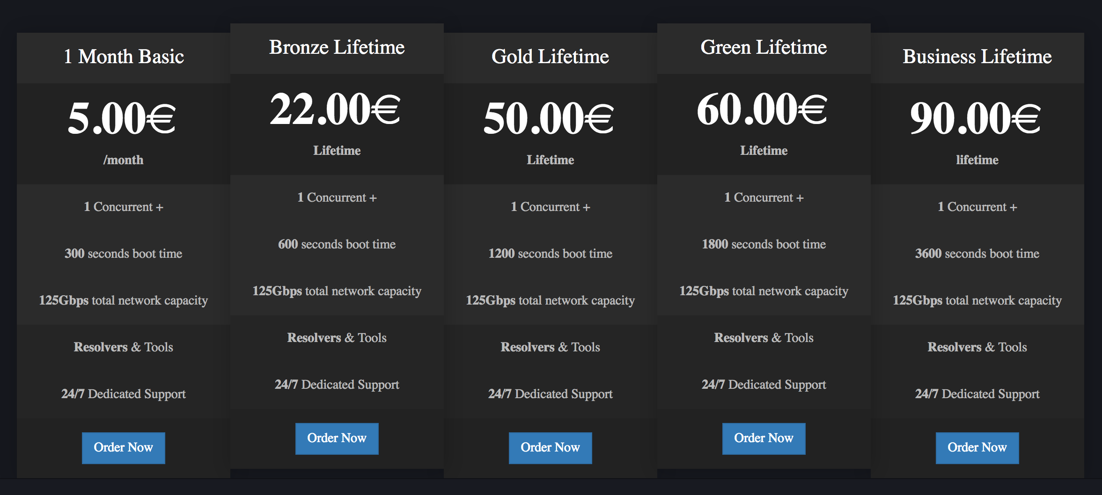
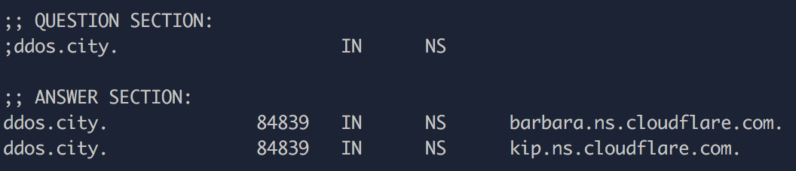
Example
Notes:
Criminal infrastructure is typically well supported and can often be run as a fully functional business

Slide 27
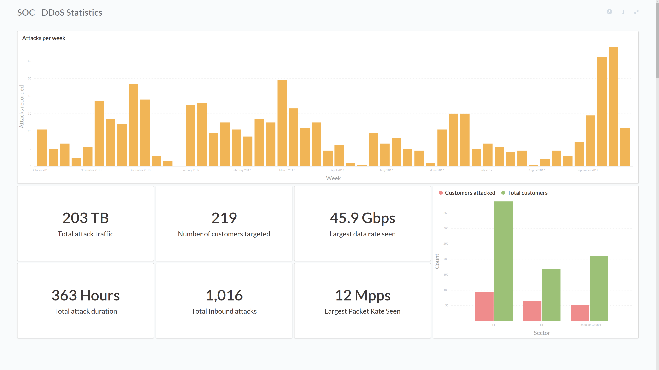
Attacks per week
60
50
40
30
20
10
0
Oct-16
Nov-16
Dec-16
Jan-17
Feb-17
Mar-17
Apr-17
May-17
Jun-17
Jul-17
Aug-17
Sep-17
350
300
250
200
150
100
50
0
FE
HE
School/council

Slide 28
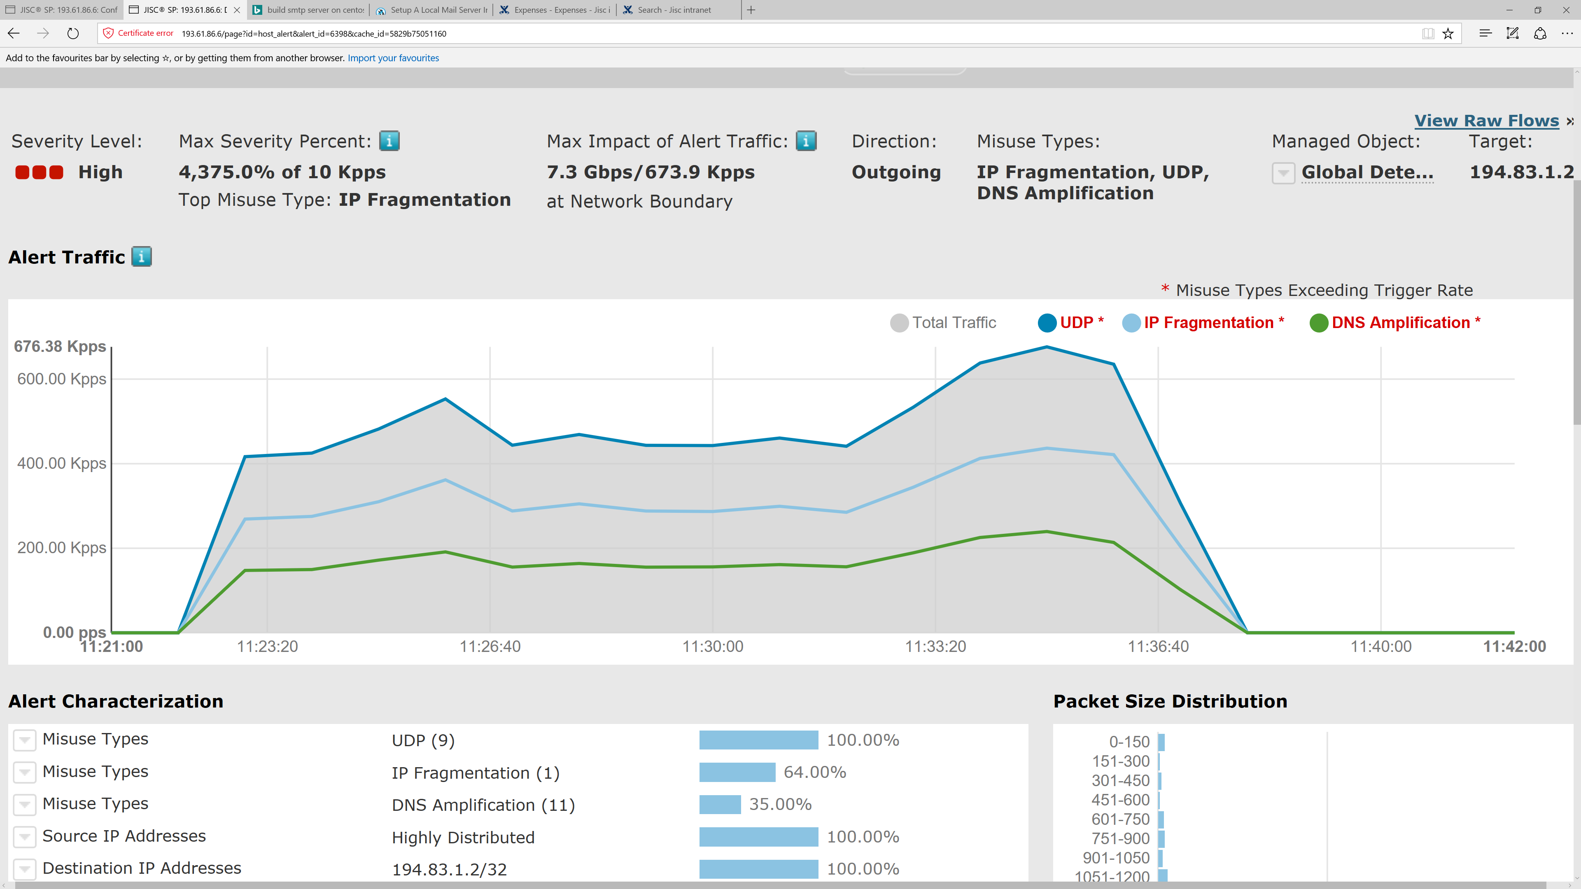
What we’ve seen…
Attacks are getting bigger – typically seeing 5Gbps+ on an average day
Notes:
As we heard in the introduction from Bob we are not having to deal with a changing threat landscape

Slide 29
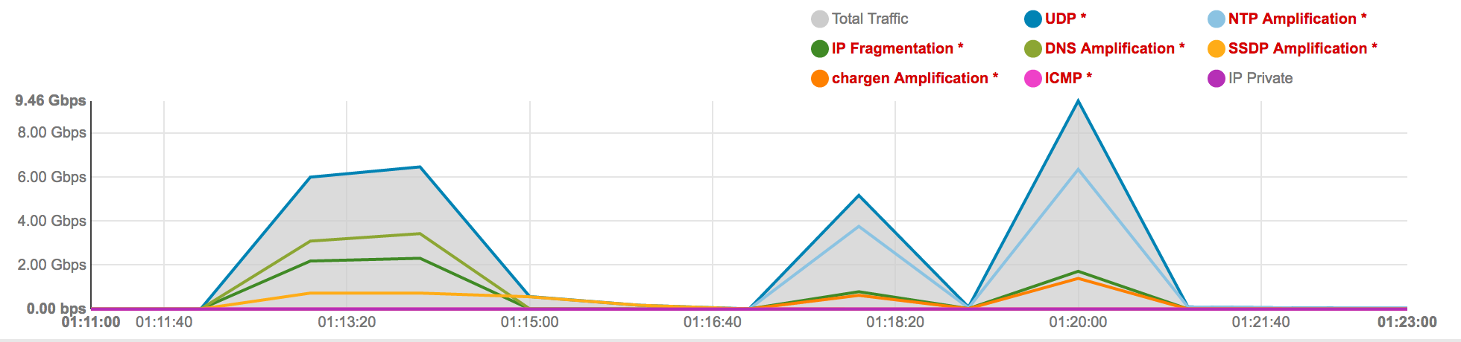
What we’ve seen…
Multiple attack vectors are being used simultaneously

Slide 30
Top Five Tips
Identify your organisations critical assets or key information and assess the risk of exposure of which would have a major impact on the organisation
There's little point investing in securing your devices, networks, and services, if you don't maintain and enhance their cyber security throughout the period that they are deployed.
The most important activity to prevent common cyber attacks is to keep your technology up to date, and to apply the latest security patches as they're made available.
Cyber security mitigations will not be infallible; occasionally attackers will be successful. Taking steps to ensure that you can detect when cyber attacks have occurred (and knowing how to quickly recover from them) will pay dividends in the long run.
It is essential that you always back up your important information and have a plan for recovering from a system failure. An attacker could crash a network or computer's operating system or data may be corrupted or wiped out by a hardware problem

Slide 31
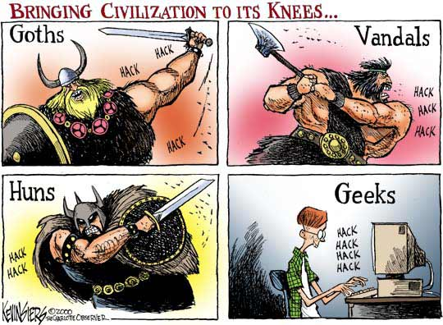

Scary but true

