Slide 1
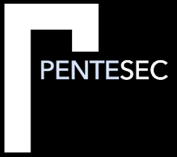
Check Point Infinity
The case for a security architecture
Tim Chambers - Sales Manager Pentesec Ltd.
Check Point 4 Star Elite Partner
Notes:
About me – involved with Check Point for 20 years

Slide 2
Check Point Software Technologies Ltd. - an overview
Established in 1993 Check Point pioneered the I.T. security industry with FireWall-1
2006 - Check Point creates a unified security architecture
2009 - Check Point introduces its customisable Software Blade architecture
Check Point defines security as a business process with 360 Degree Security combining policy, people and enforcement
Tens of thousands of organizations of all sizes use Check Point
Foundation of Check Point’s success:
- customer-driven philosophy
- continuous technological innovation
- pure focus on providing comprehensive and innovative security
Notes:
introduced patented Stateful inspection technology which is still the foundation for most network security technology today
single management console and a single agent for endpoint security
meet the exact security needs of any organization or environment
to help organizations implement a blueprint for security that aligns with business needs

Slide 3
Pentesec Ltd. - an overview
Incorporated in 2014
Cyber Security Consultancy
Core of the business is Check Point and provide a blend of traditional and emerging technologies
Check Point 4 star Elite Partner
Most Certified Global Check Point Partner with specialisms including Endpoint and vSEC
Accredited Check Point Training Provider
Customers across all sectors including; NHS, Central Government Ministries, Local Government, National Infrastructure and the Private Sector
Notes:
Industry experienced professional

Slide 4
What Threats are we facing today?
Everything is connected – The Internet of things
The most dangerous tools – NSA hacking tools leaked and sold online
Ransomware – Wannacry / Petya
Mobile Attacks – 1 Million Google Accounts breached by Gooligan

Slide 5


What Should We Expect Next Year?
Attacks Will Continue to grow. We are all targets
ADVANCED THREATS
CLOUD
MOBILITY
Our networks will still be targeted!
The shift is accelerating
Fundamental part
of each business
Notes:
What are the advanced threats?

Slide 6
Advanced Threat Protection tools exist but are STILL Insufficiently used
What we know
100%
NOT
PROTECTED
93%
99%
98%
50%
PROTECTED
0%
ADVANCED THREAT PREVENTION
MOBILE SECURITY
CLOUD SECURITY
Notes:
the TE usage data shows 7% for EU (764/ 11078) which is identical to the WW usage of TE.
Top countries of TE in EU for Q4 are Germany, UK and France.

Slide 7
The Explanations
It’s too complicated
I didn’t realise it was such a problem
Too many point products
Not enough trained people
I didn’t think it could hurt us

Slide 8





ARCHITECTURE A
MULTI-VENDOR, ATTACK DETECTION
AND MITIGATION
USING POINT SOLUTIONS…
Firewall
POINT SOLUTIONS:
Too many disparate technologies
Technology B
INHERENT GAPS:
Incomplete coverage between solutions
Technology C
POST BREACH:
Detection & mitigation tools to minimize the damage
Mitigation Tools
Breach
Detection and
Remediation
“Attacks are inevitable, so we might as well mitigate the damage”

Slide 9

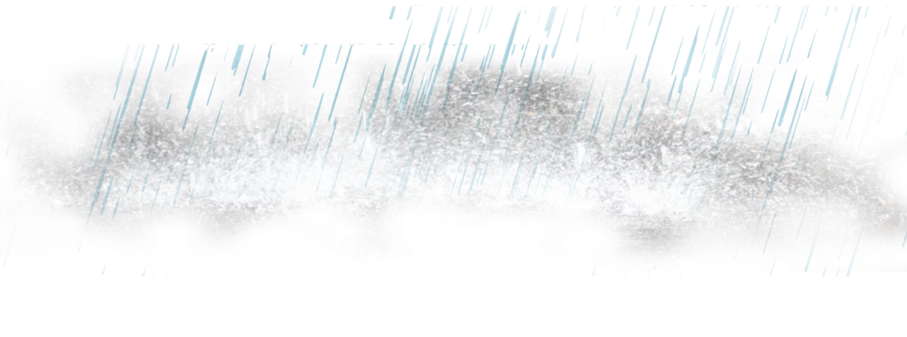
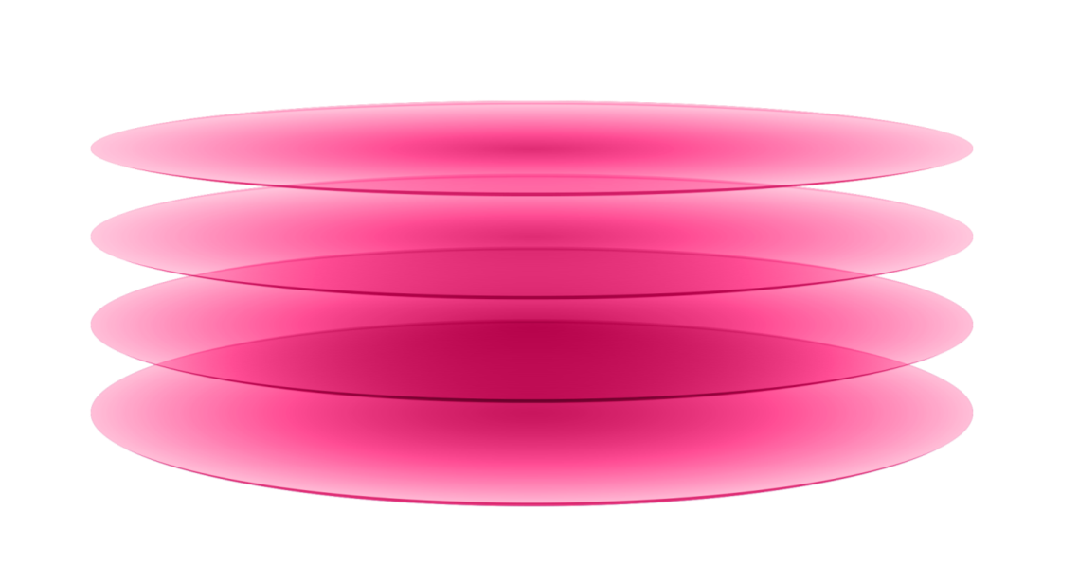


ARCHITECTURE A
We All
Need Protection
ARCHITECTURE B
MULTI-VENDOR, ATTACK DETECTION
AND MITIGATION
UNIFIED ARCHITECURE
FOCUS ON PREVENTION
Firewall
Next Generation Firewall
Threat Prevention (AV, IPS)
Technology B
Advanced Threat Prevention
Technology C
Cloud Mobile Networks
UNIFIED
ARCHITECTURE
Mitigation Tools
Breach
Detection and
Remediation

Slide 10


How Check Point are addressing this - effective Security that meets business needs
Managing mobile, cloud and network environments
CONSOLIDATED
SINGLE ARCHITECTURE
Security policy
that expresses
your business
needs
Integrated
Threat
Prevention
Auto-scaling
with
your cloud

Slide 11


CYBER SECURITY ARCHITECTURE
FOCUS ON THREAT
PREVENTION
CONSOLIDATED SYSTEM
ONE SECURITY PLATFORM
Leveraging unified threat intelligence & open interfaces
Blocking the most sophisticated attacks before they happen
Single Management, Modular Policy Management & integrated threat visibility
ACROSS ALL NETWORKS, CLOUDS AND MOBILE

Slide 12
An example of Check Point Infinity combatting
a targeted cyber campaign

Slide 13
File hash: 4931c1259863e1ba59201e…
C&C server: pwnown.hack.evil
…
Incoming email with PDF attachment blocked
Access to web site on mobile device was blocked
Virtual machine on public cloud was quarantined
11:30
11:32
11:35
Zero-day malicious PDF detected by Check Point Sandbox
Address of remote C&C identified in malicious PDF
Exposed indicator shared
with ThreatCloud
Malicious link identified by the exposed indicators
Detected infection (bot) on cloud virtual machine.
Communication with C&C identified by indicators

Slide 14
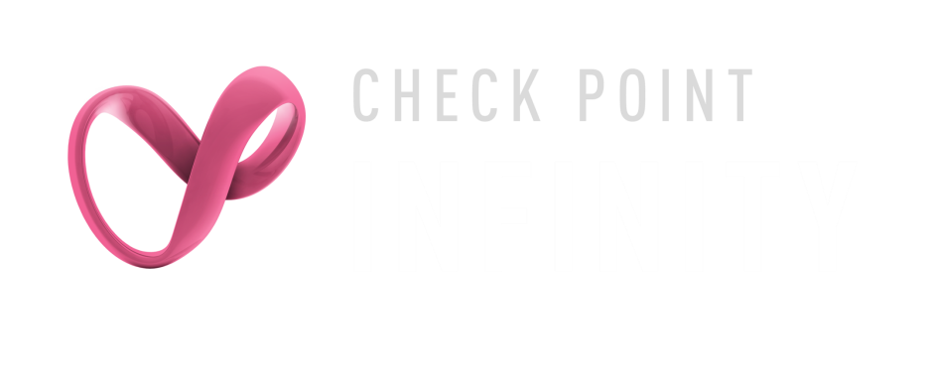
Incoming email with PDF attachment blocked
Access to web site on mobile device was blocked
Virtual machine on public cloud was quarantined
11:30
11:32
11:35
Shared intelligence and threat prevention across networks, mobile, cloud
One consolidated system to fully block the attack

Slide 15





CLOUD
MOBILE
THREAT PREVENTION
CONSOLIDATED
SYSTEM
Notes:
As described earlier - Check Point Infinity is the first consolidated security across networks, cloud and mobile, providing the highest level of threat prevention

Slide 16
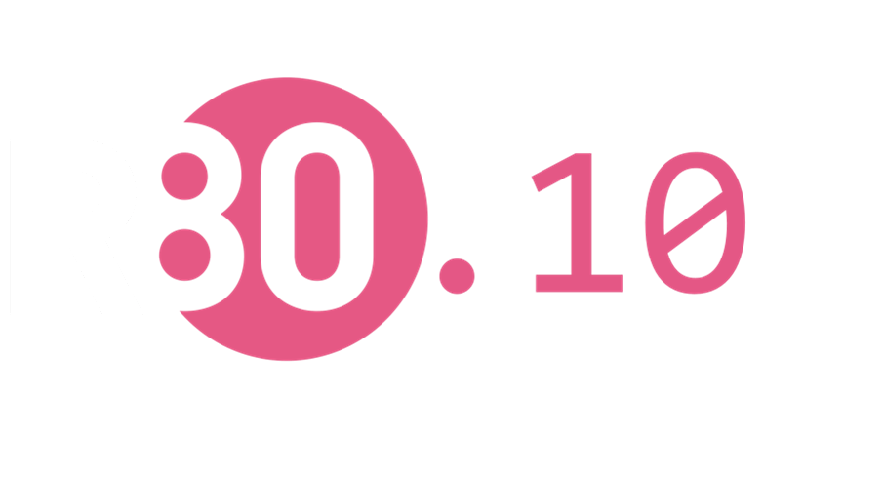
  Check Point R80 – The Security Platform of the Future
  Consolidating Networks, Cloud and Mobile
NEXT GENERATION POLICY MANAGEMENT
EFFICIENT, AUTOMATED OPERATIONS
INTEGRATED THREAT MANAGEMENT

Slide 17
To Summarize
Cyber Protections are available
But are not adopted by over 93% of organisations
Prevention is possible
Detection of the breach is too little, too late
The next attack can be prevented

Slide 18
How Pentesec Ltd. can help you?
Free Security Check Up
Scheduled Check Point Webex
Check Point Training
Notes:
What are we providing

Slide 19
Thank You

